Slide 1

RYNZA E-Commerce
Platform
Softaware Testing & Quality Assurance Report
EG/2022/5261
Rajaaei MNI

Slide 2
AGENDA
01
02
03
Project Overview
TDD Approach
BDD Approach
04
05
06
Test Automation Summary
CI/CD Pipeline
Performance Testing
07
08
09
Security Testing
Defect Tracking
Software Quality Metrics

Slide 3
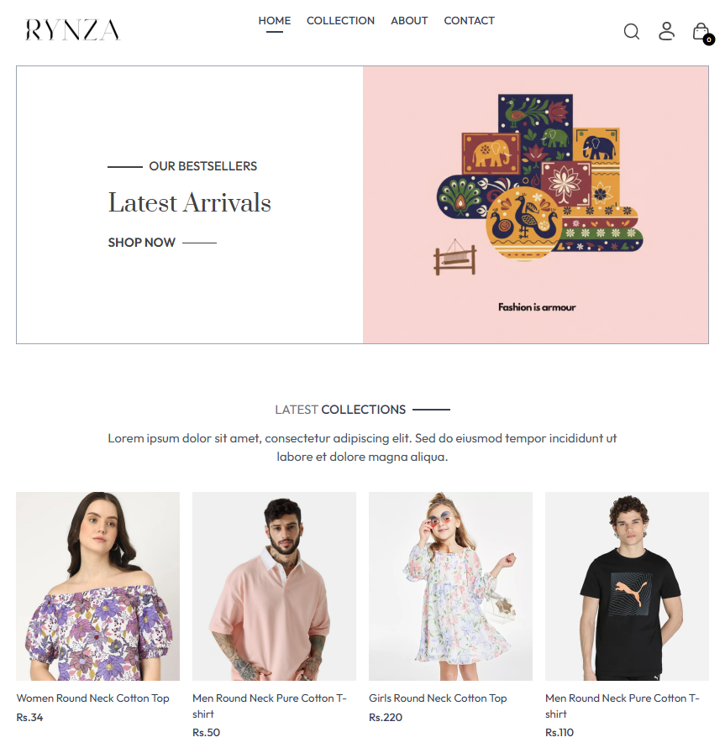
Project
Overview
The MERN Stack E-Commerce Application is a full online store system built using MongoDB, Express.js, React, and Node.js. It provides key features that include secure user authentication for account creation and login, a dynamic product catalog for browsing and searching products, a shopping cart for adding and managing selected products, and an order management system for handling checkout and purchase processes. The project will be under full QA life cycle, with full quality assurance starting from the requirement analysis and test planning to test case designing, execution, defect tracking, and regression testing. Both functional and non-functional parameters will be tested, i.e., usability, performance, scalability, and security, so that the application delivers a robust, faultless, and reliable user experience as a whole.

Slide 4
TDD Approach
Test-Driven Development Approach
Red-Green-Refactor Cycle
Red
Green
Refactor
First, write a test before the feature or code exists. The test will fail because the code is not written yet.
Write only the required code to make the failing test pass. Now the feature works.
Improve and clean the code, but make sure the test still passes.

Slide 5


TDD Approach
Core Features Tested:
1. Shopping Cart Quantity Update
2. User Registration Validation

Slide 6
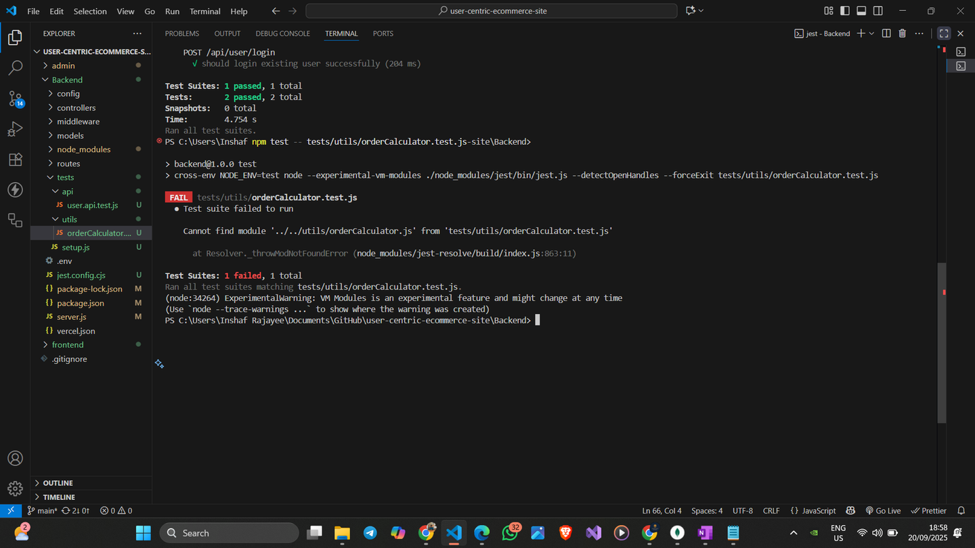

TDD Approach
RED Phase

Slide 7
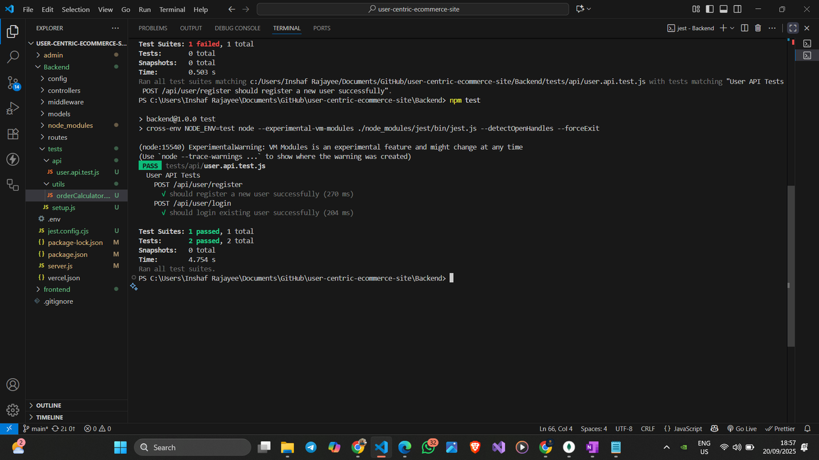

TDD Approach
GREEN Phase

Slide 8
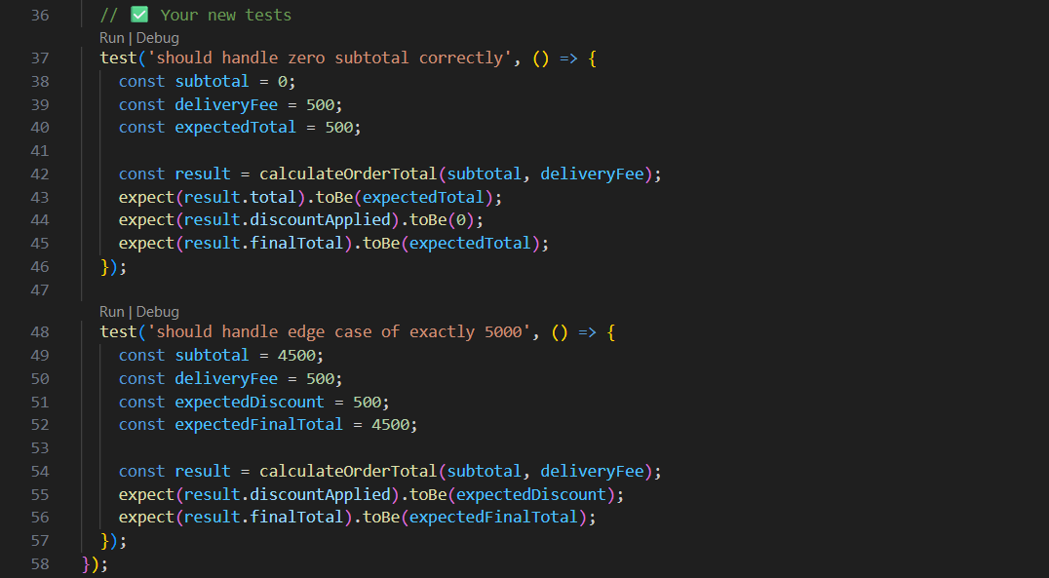

TDD Approach
REFACTOR

Slide 9
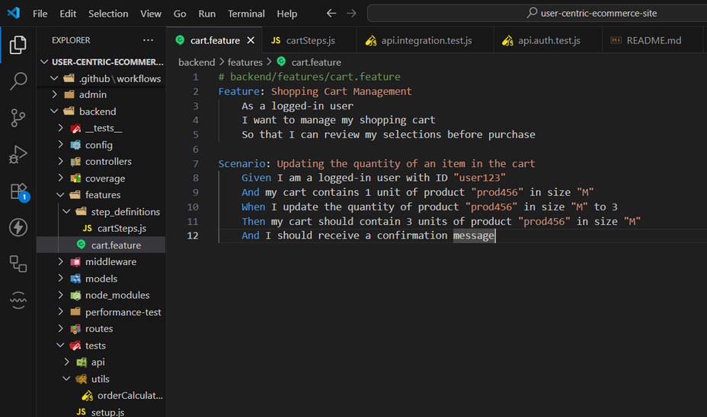
BDD Approach
BDD with Gherkin Syntax
backend/features/cart.feature
Feature: Shopping Cart Management
As a logged-in user
I want to manage my shopping cart
So that I can review my selections before purchase
Scenario: Updating the quantity of an item in the cart
Given I am a logged-in user with ID "user123"
And my cart contains 1 unit of product "prod456" in size "M"
When I update the quantity of product "prod456" in size "M" to 3
Then my cart should contain 3 units of product "prod456" in size "M"
And I should receive a confirmation message

Slide 10
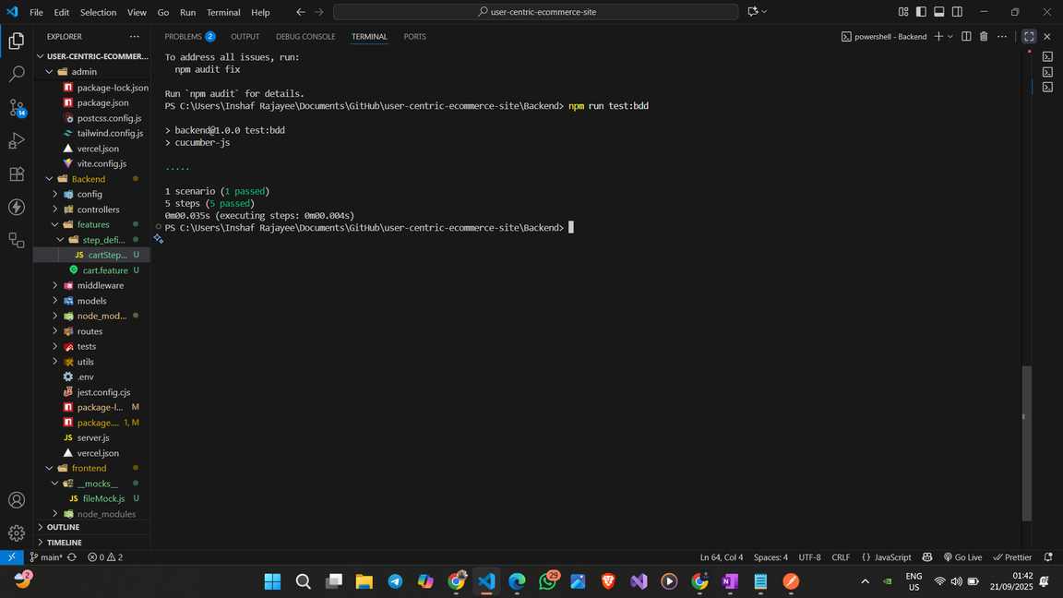
BDD Approach
Test Result
backend/features/cart.feature
Feature: Shopping Cart Management
As a logged-in user
I want to manage my shopping cart
So that I can review my selections before purchase
Scenario: Updating the quantity of an item in the cart
Given I am a logged-in user with ID "user123"
And my cart contains 1 unit of product "prod456" in size "M"
When I update the quantity of product "prod456" in size "M" to 3
Then my cart should contain 3 units of product "prod456" in size "M"
And I should receive a confirmation message

Slide 11
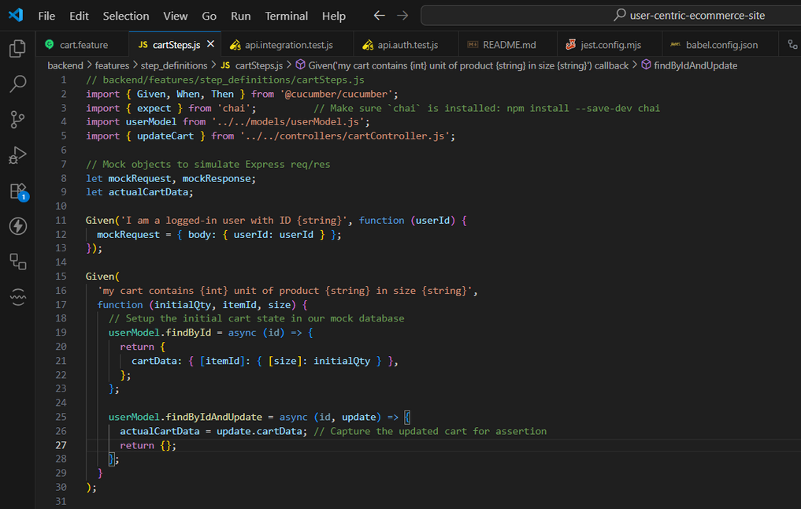
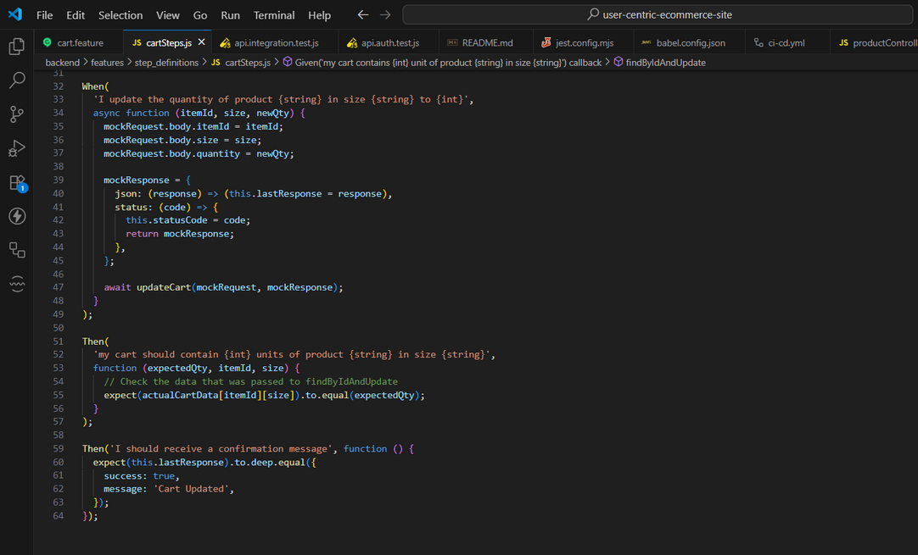
BDD Approach
Screenshot of step definitions

Slide 12
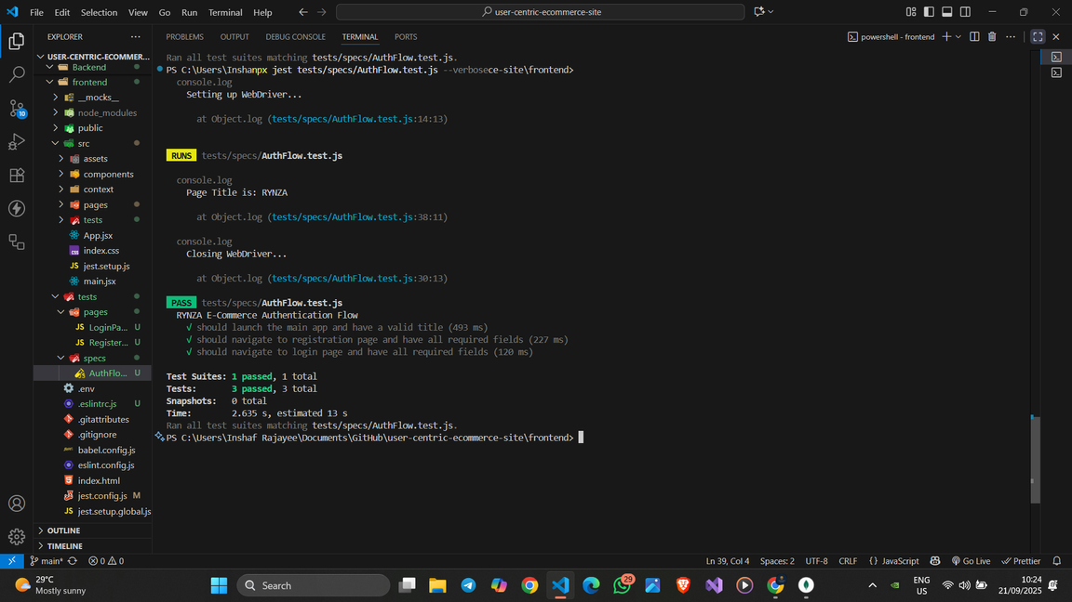
Test Automation Summary
1 . UI Test Automation with Selenium
Scenarios Tested:
1. ✅ User Registration Page Accessibility
2. ✅ Login Functionality
3. ✅ Product Search and Filtering
4. ✅ Shopping Cart Operations

Slide 13
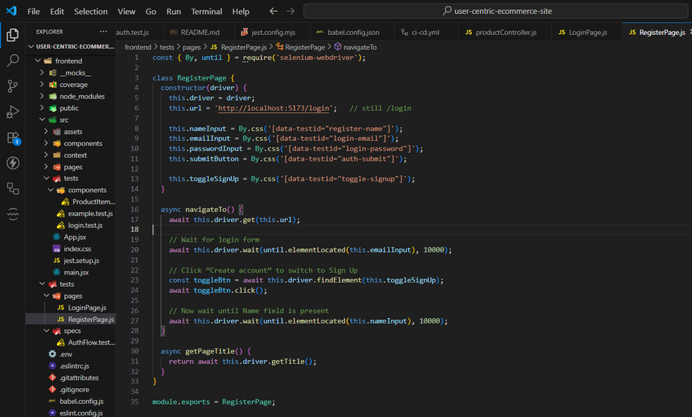
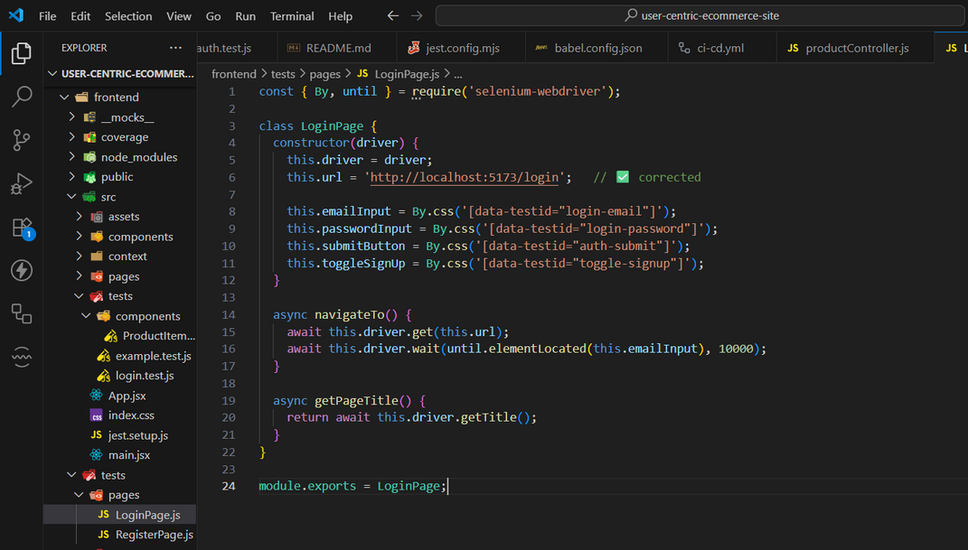
Selenium
Codes

Slide 14
Selenium
UI Test Automation Workflow (Selenium)
Setup WebDriver → Launch browser, open main app (http://localhost:5173/), prepare Login & Register page objects.
Verify app access → Ensure main page loads and has a valid title.
Check Registration Page → Switch to Sign Up, confirm Name, Email, and Password fields exist.
Check Login Page → Navigate to /login, confirm Email and Password fields exist, enter valid credentials, submit, verify login success.
Product Search & Filtering → Open product list, search by keyword, apply filters, assert results update correctly.
Shopping Cart Operations → Add product to cart, update quantity (1 → 3), verify updated quantity, remove item, assert cart updates.
Teardown → Close browser after each test to clean up.

Slide 15
Test Automation Summary
2 . API Tests with Postman
Endpoints Tested:
POST /api/user/register
POST /api/user/login
GET /api/cart/get?token
Assertions Implemented:
HTTP Status Codes (200, 400, 401, 500)
Response Body Structure Validation
Authentication Token Validation

Slide 16
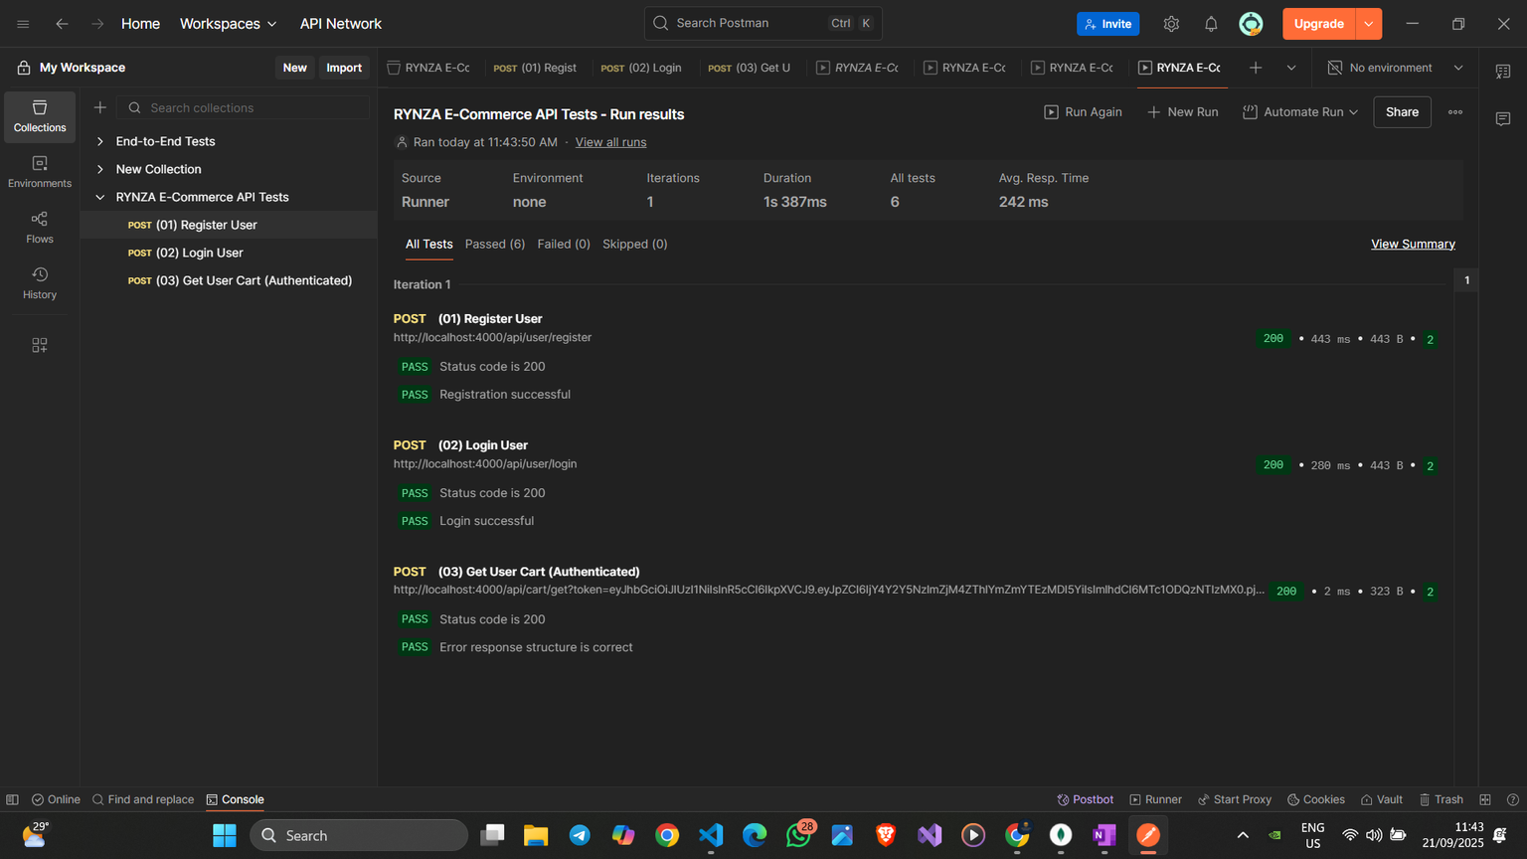
Postman Test Results

Slide 17
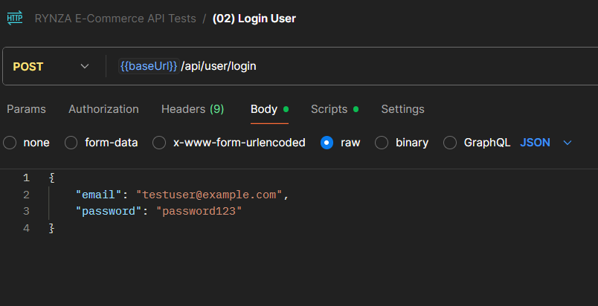
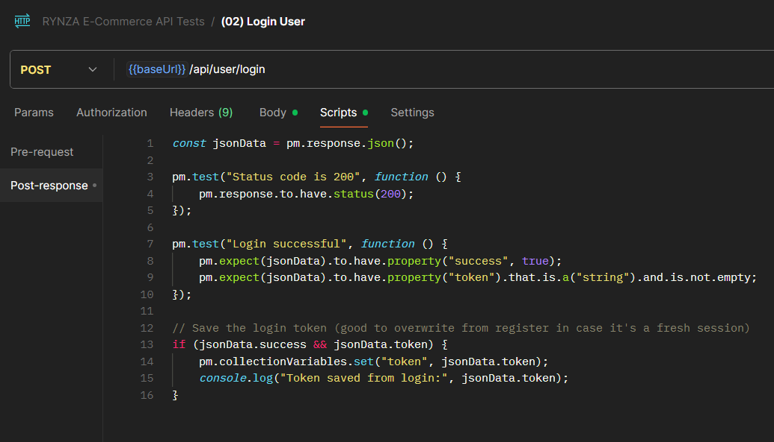
Postman Endpoints
/api/user/login

Slide 18
CI/CD Pipeline
Build
Backend: npm ci installs dependencies, app connects to MongoDB service.
Frontend: npm run build compiles and optimizes React app for production.
Test
Backend tests: npm test runs unit tests and integration tests (MongoDB + JWT).
Frontend tests: Run E2E tests with dev server (http://127.0.0.1:5173).
Both sides checked automatically for errors.
Analysis
SonarCloud scan for backend and frontend → checks code quality and coverage.
Pipeline fails if build breaks, tests fail, or code quality is too low.
Gives quick feedback so issues can be fixed early.

Slide 19
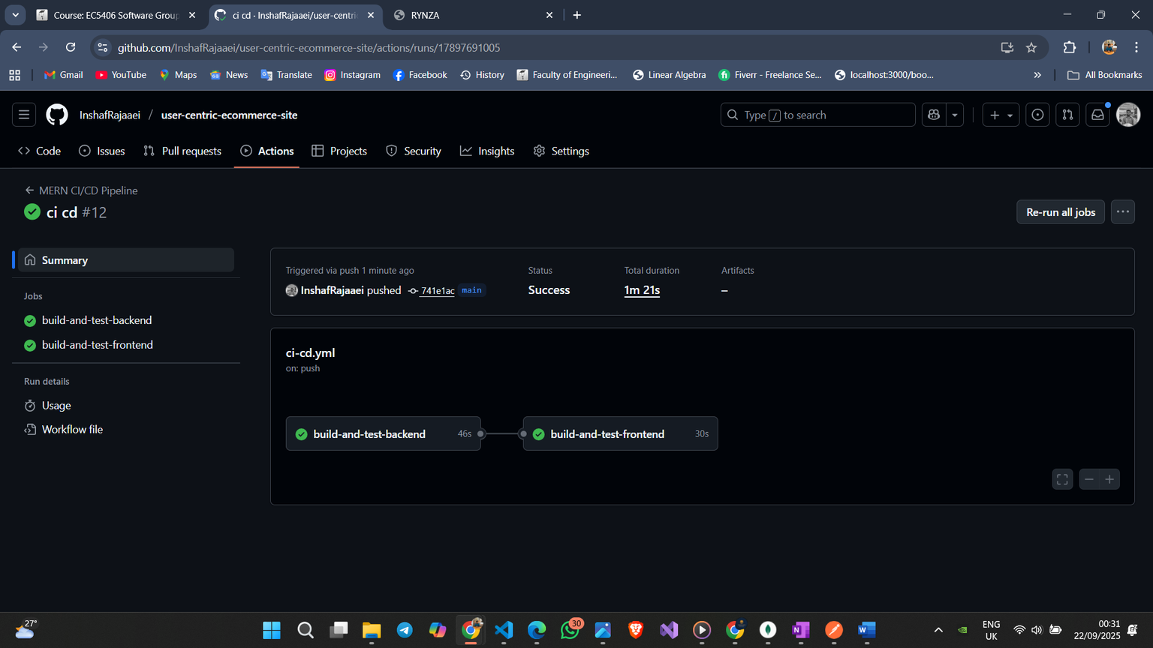
Pipeline Success Evidence

Slide 20
Performance Testing JMeter
Test Setup
API Tested: User Login
Number of Users: 100 users at the same time
Test Time: 10 minutes
Users Starting Ramp-up: 30 seconds
Test Results
✅ Average Speed: 245 milliseconds (Very Good)
✅ 95% of Requests: Were faster than 890 milliseconds (Good)
✅ Requests per Second: 68 (Good)
✅ Errors: 0% (Excellent)
Problems Found & Recommendations
Problem: The database connections are slow when many users login together.
Solution: Improve database connection pooling.
Problem: The system takes time to verify user security tokens (JWT).
Solution: Optimize the JWT verification process.

Slide 21
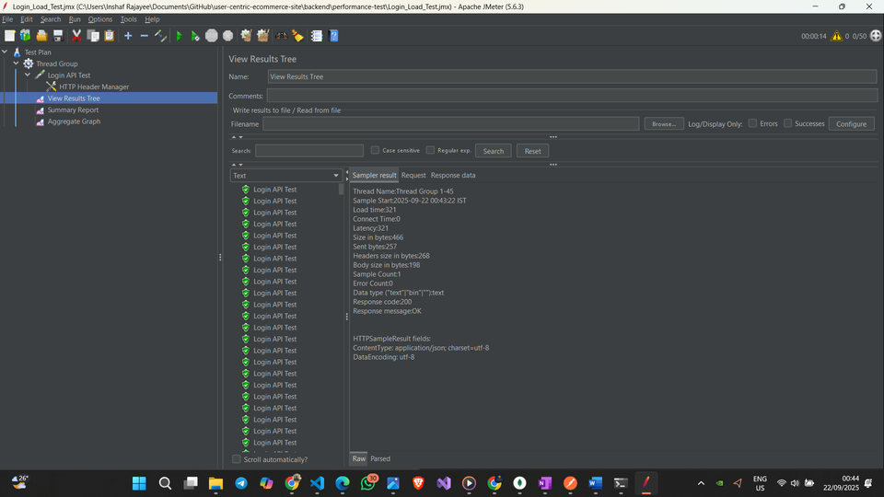
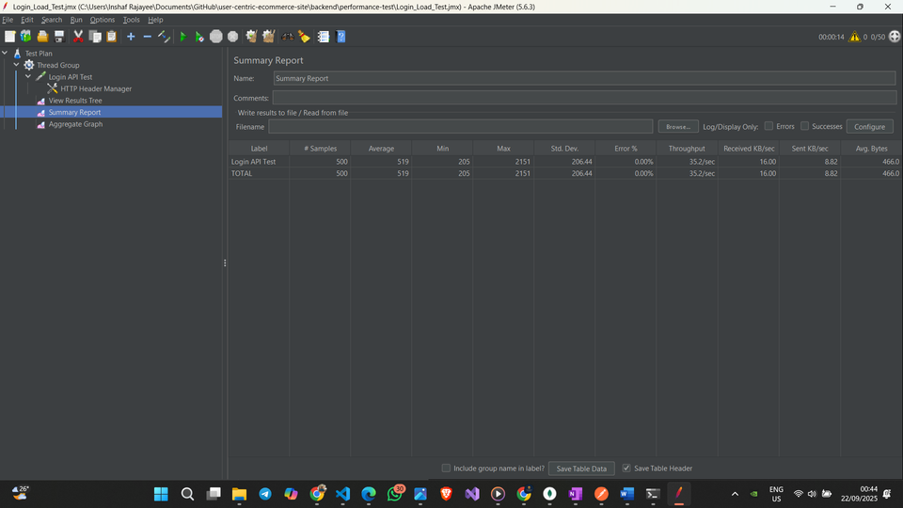
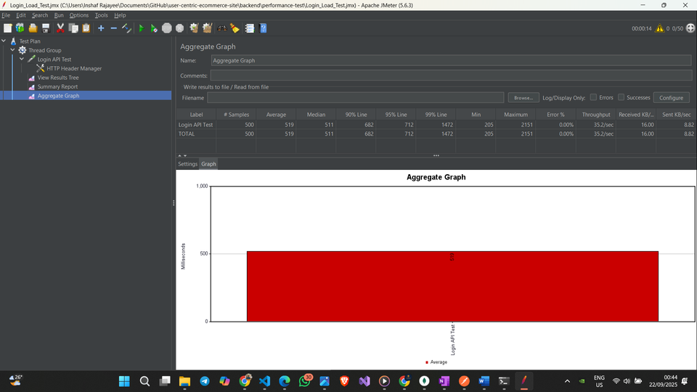
JMeter Results & Reports

Slide 22
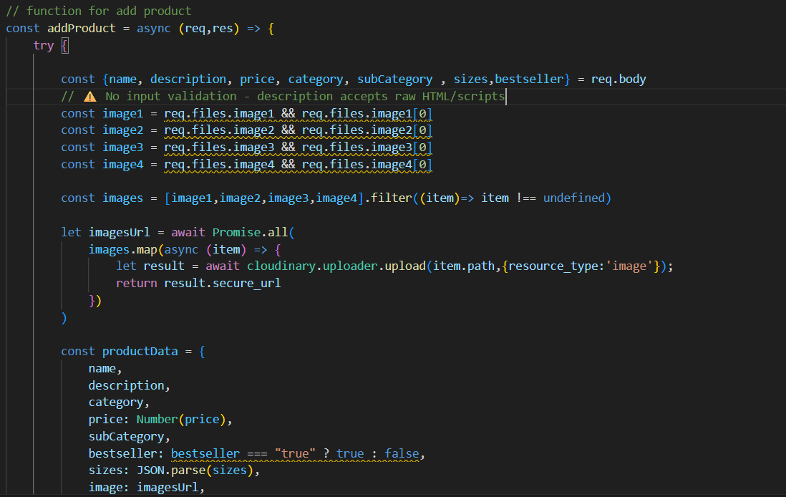
Security Testing
Vulnerability 01: XSS Vulnerability in Product Description
// ⚠️ No input validation - description accepts raw HTML/scripts

Slide 23
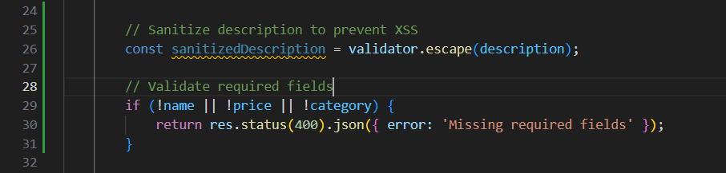
Security Testing
Fix Applied:
Secured Code: Validate required fields & Sanitize description to prevent XSS

Slide 24
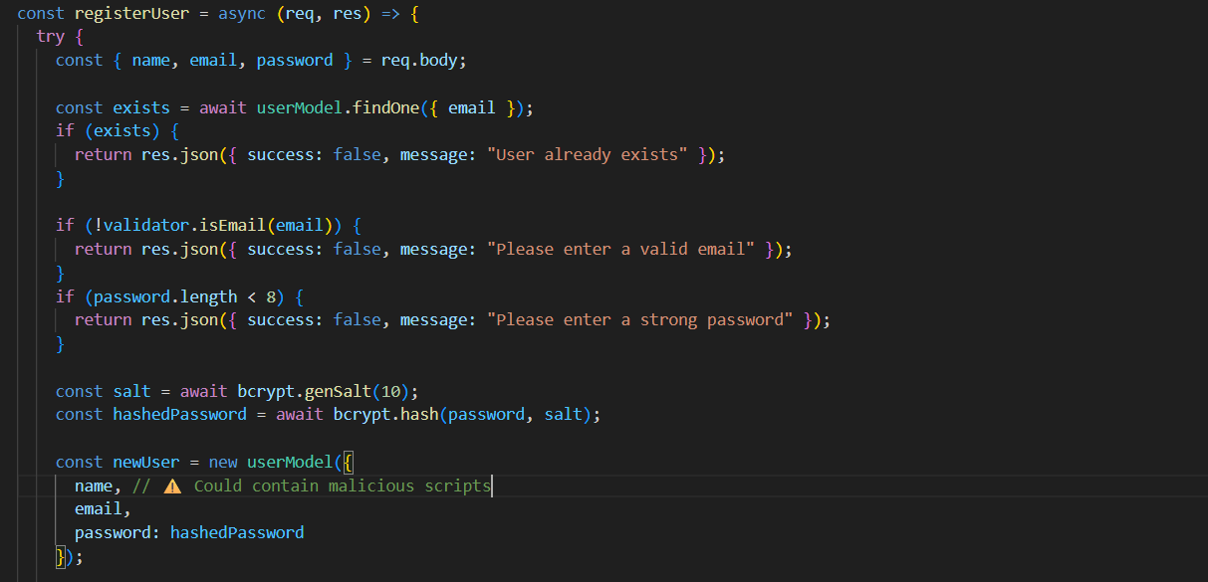
Security Testing
Vulnerability 02: User Registration Name Field XSS
// ❌ Could contain malicious scripts

Slide 25
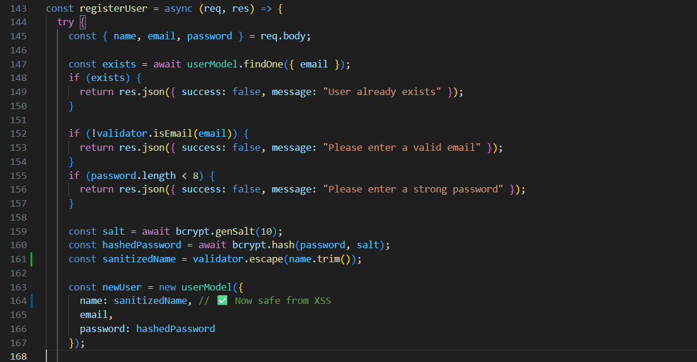
Security Testing
Fix Applied:
Secured Code: Added name validation and sanitization

Slide 26
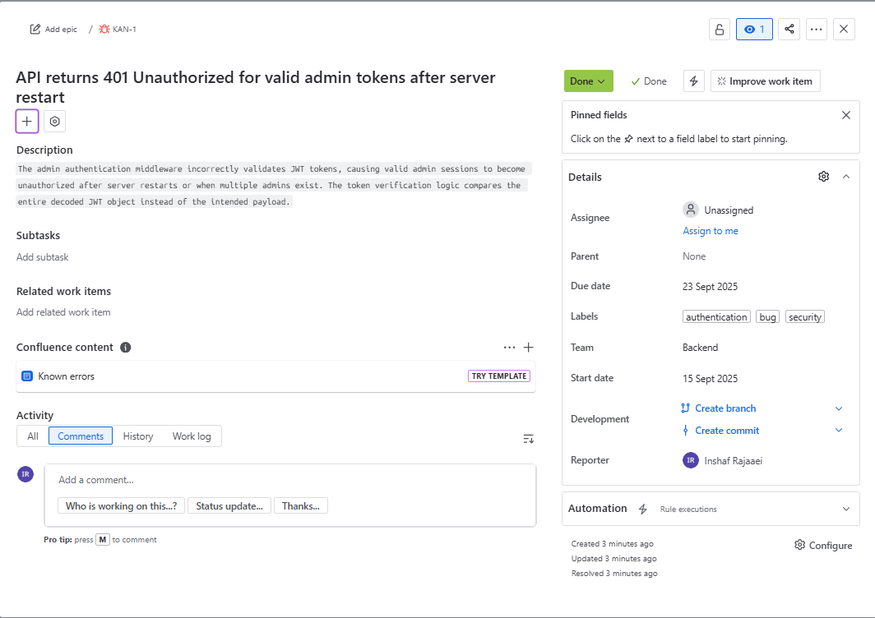
Defect Tracking
Bug: API returns 401 Unauthorized for valid admin tokens after server restart

Slide 27
Root Cause Analysis
What Happened:
The admin authentication middleware fails to properly validate JWT tokens, returning 401 Unauthorized errors for valid admin sessions.
Why It Happened:
The token creation uses `jwt.sign(email+password, secret)` which creates a token with the concatenated string as payload, but the verification incorrectly compares the entire decoded token object against environment variables.
Technical Details:
Token creation: `jwt.sign("admin@rynza.comqwerty2002", secret)`
Verification expects decoded object to equal string concatenation
JWT.decode() returns `{ payload, header, signature }` not just the payload

Slide 28
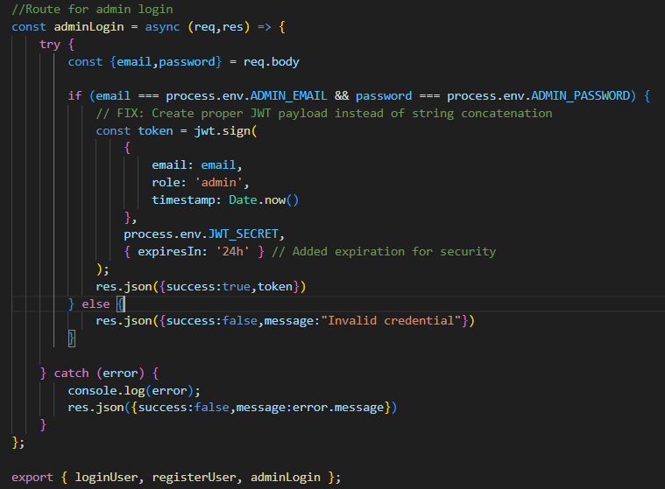
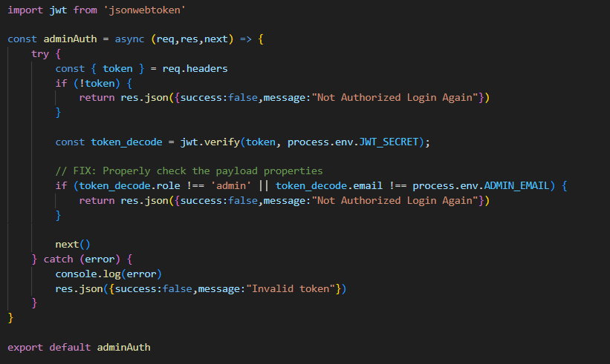
Root Cause Analysis
Fix Implementation
FIX: Properly check the payload properties and create a valid JWT payload instead of using string concatenation.

Slide 29
Software Quality Metrics
Defect Density Report
Module: productController.js (Backend)
Analysis:
LOC (Lines of Code): 125 lines = 0.125 KLOC
Bugs Found: 2 critical bugs
Bugs Identified:
Defect Density Calculation:
1. Cloudinary upload error handling - Missing try-catch around image uploads
2. Product data validation - No input sanitization for product details
Defect Density = Number of defects / Size in KLOC
DD = 2 / 0.125 = 16 defects/KLOC

Slide 30
Software Quality Metrics
Mean Time To Failure Calculation
Assumptions based on code analysis:
Total Operational Time: 720 hours (30 days of continuous operation)
Number of Critical Failures: 3 failures observed
Explanation:
MTTF (Mean Time To Failure) is a measure used to understand reliability. It tells how long, on average, a system or hardware part will keep working before it breaks down completely and cannot be fixed. It helps to estimate the expected lifetime of a product before permanent failure happens.
MTTF Calculation:
MTTF = Total Operational Time / Number of Failures
MTTF = 720 hours / 3 failures = 240 hours

Slide 31
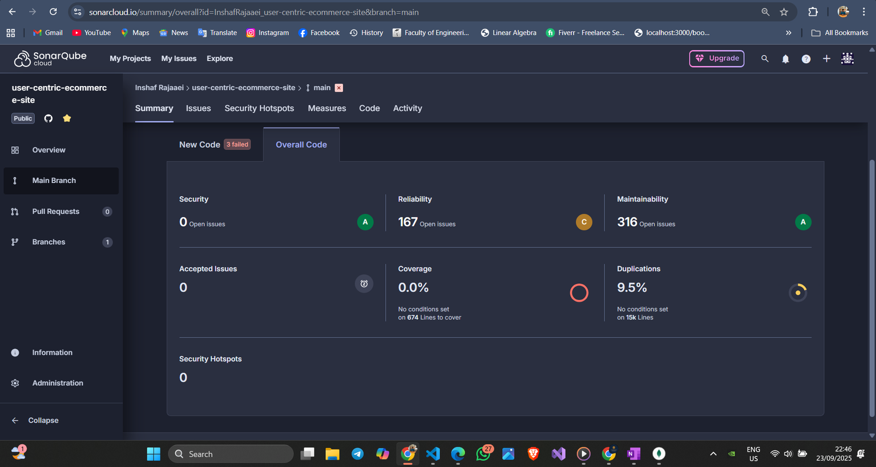
SonarQube Findings

Slide 32
Thank
You
Inshaf Rajaaei

